Slide 1


You *can* always get what you want
Mike Goulis

Slide 2

Notes:
Inedo; software and service

Slide 3
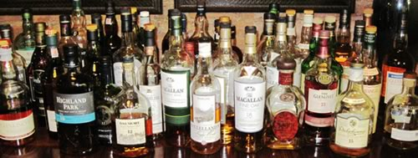
Scotch collection

Slide 4
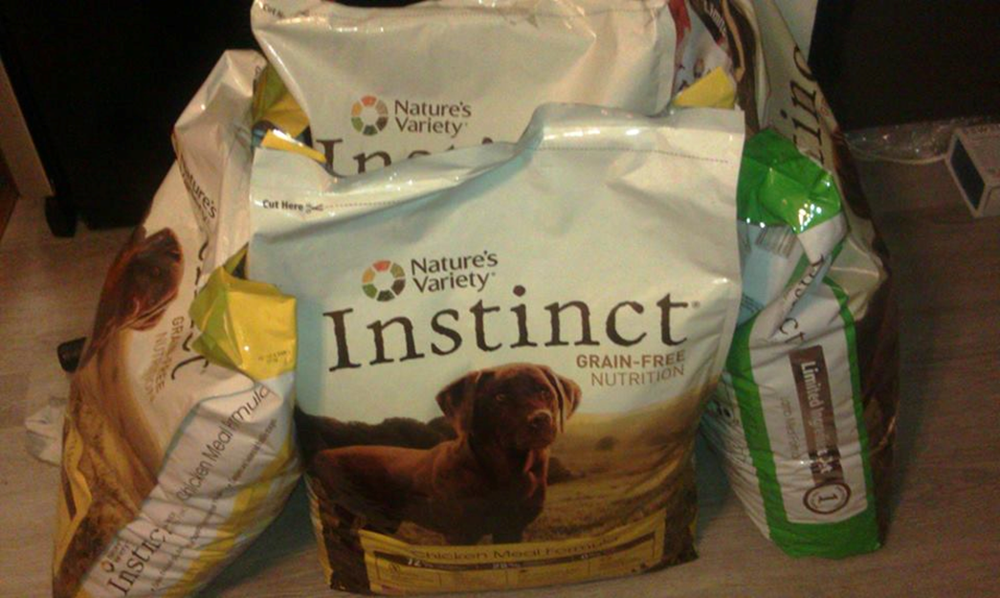
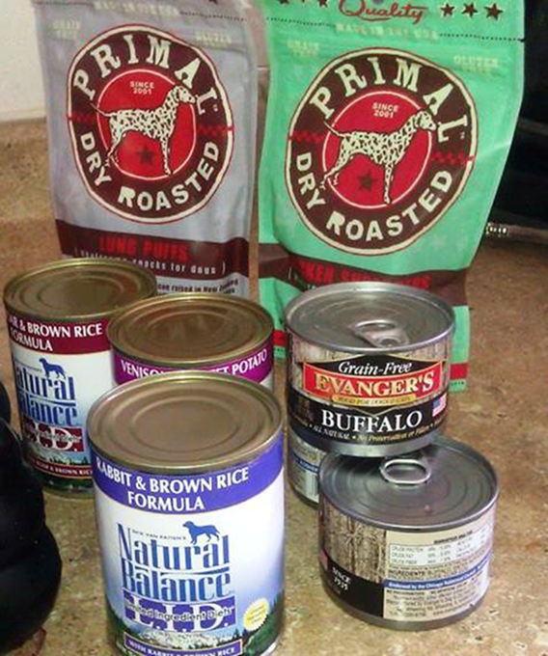
Spoiled pup!

Slide 5


Slide 6

Developers

Slide 7

Executives

Slide 8

Going up?

Slide 9

So….

Slide 10
Y U no buy?
What it does
How it does
Problem?

Slide 11

Selling is…

Slide 12
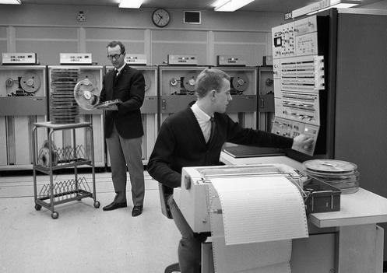
SCM
Notes:
How many of you have worked for a company that whether merged or purchased has existed more than 20 years? 30 years? 50 years?

Slide 13
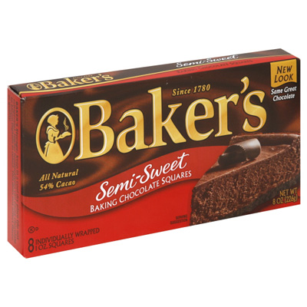









“Not their first rodeo”
Notes:
These are the 10 oldest companies in the united states. Obviously these aren’t “technology” companies. Their old time companies that create physcial goods…stuff that’s been around forever…but to have made it today their ability to manae inventory, track orders, suppliers, etc. Must have evolved through years with technology and change every step of the way. Some are more ahead than others. New York Times obviously has a pretty sophisticated online presence.

Slide 14

Fear of…

Slide 15

Origins: It’s natural!

Slide 16

High stakes

Slide 17

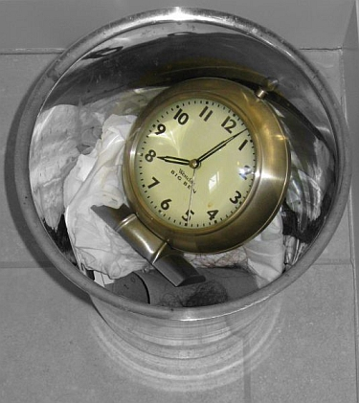
Executive Primal Fear

Slide 18
Re: High stakes

Slide 19

Going down?

Slide 20

So…

Slide 21
Would you…
Go to our site?
Watch a video?
Do a demo?
Download trial?
Introduce to peers?
Proof of concept?
Pilot buy?
Expand its use?

Slide 22

Incremental

Slide 23


Slide 24


Slide 25


Slide 26
At the table
Network Ops
Enterprise Architecture /Release Engineering, Security/Governance,
Representative of application directors and managers,
Executives
Notes:
Identify People & Policies
Assess: Champions, Anti-champions, and Adversaries
Align: Aha, Enable, Politics
Execute: Incrementally, Group by Group, and Expect Failure
Don’t lose focus. Devops is about delivering better business value, so you should always be asking yourself… what I’m doing…

Slide 27

Angular JS

Slide 28
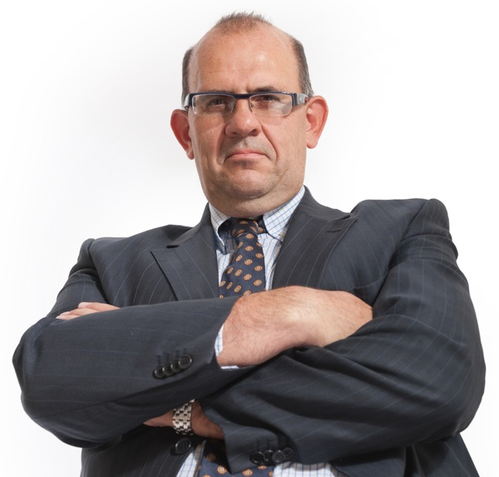
Skeptical boss

Slide 29


Slide 30
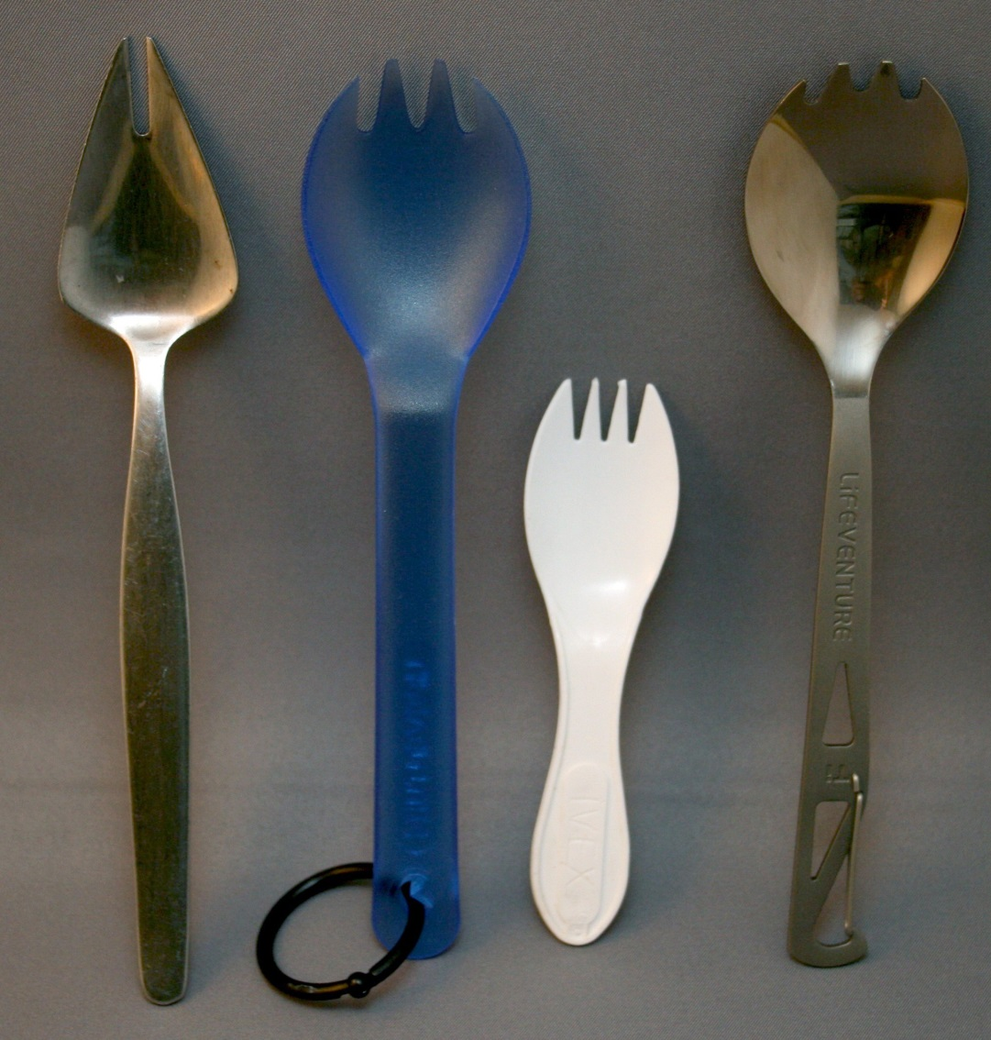
Too much

Slide 31



Fads

Slide 32


Slide 33
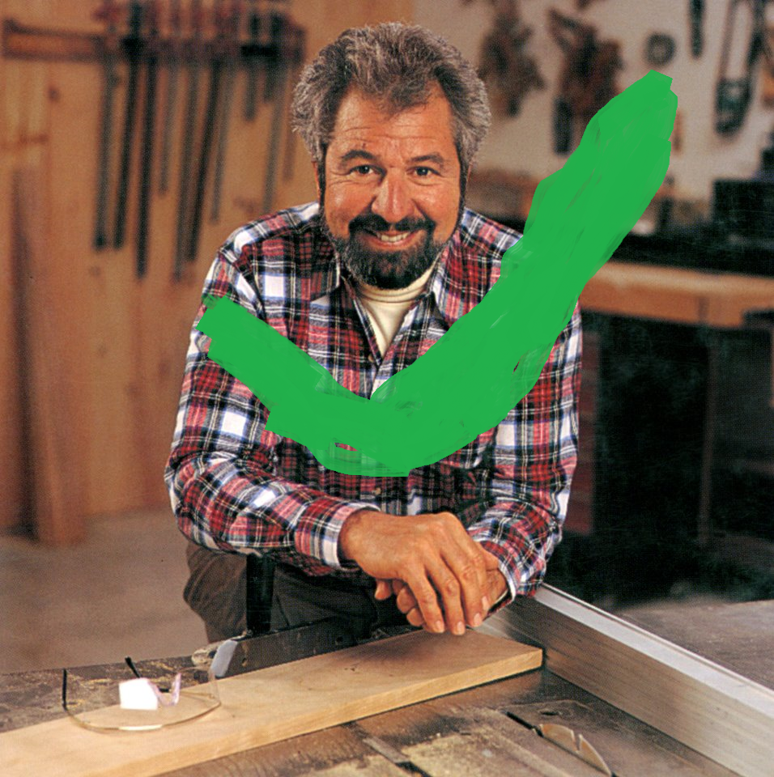

Slide 34

CodeSOD

Slide 35
Selling Angular Js
Find prototype
Bad UI
1-2 hours new UI
Only UI
DO NOT PRESENT
Estimate total

Slide 36
Cont.
Long-term adoption list
Best starting point
Low risk
Ready to present!

Slide 37


Slide 38
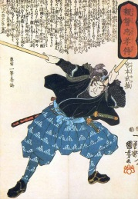
The ‘way’ broadly

Slide 39
``
“if you know the way broadly you will see it in all things.”- Miyamoto Musashi, 1584 -1645)
Thank you for listening!

